Slide 1
UNIT 4

Slide 2
COLLECTIONS AND FRAMEWORKS
Definition and need of Java Collections Framework:
A collection is a java object that is used to group homogeneous and heterogeneous and duplicate and unique objects without size limitation for carrying multiple objects at a time from one application to another application among multiple layers.
What are Collections?
Collections: It is a mechanism of collecting some group of objects either statically or dynamically. Collections can hold a group of objects. The size of the collection is not fixed, it means when we are inserting and deleting the elements than the size of the collection dynamically increased or decreased.

Slide 3
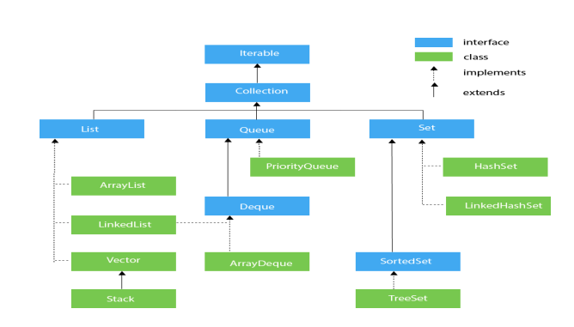
Every collection internally follows data structures and contains predefined functions it means we don’t need to write new logic for performing the operations like Insertion, Deletion, Searching, Sorting, etc.

Slide 4
What is a Framework?
The framework is a semi-finished reusable application that provides some common low- level services for serving reoccurring problems and that can be customized according to our requirements.
For example: 1. The computer is a framework; it can be used by all people according to their requirements.
2. In java struts, hibernate, spring technologies are frameworks, all these technologies are used by different companies for developing projects according to the project requirements.

Slide 5
Collection Object:
An object is said to be a collection object if it holds or stores a group of other objects. The collection never stores any primitive values, but if we want to store primitive values we have to represent primitive values as objects.
Collection Class:
Collection class is a class whose object can store a group of other objects. Example: ArrayList, HashSet, HashMap, etc. All the collection classes are available in the “java.util” (utility) package. All the collection interfaces and collection classes together form a Collection Framework.

Slide 6
List:
It is used to store a group of individual elements where the elements can be duplicated and arranged in ordered.Elements can access using indexing.
2. Set:
It is used to store a group of individual elements but the elements can’t be duplicated.Need to use itarator inorder to acess an element.
3. Queue:
It is used to hold multiple elements prior to processing and is dedicated to storing all the elements where the order of the elements matter.
4. Map:
It is used to store the element in the form of key value pairs where the keys can’t be duplicated but values can be duplicated

Slide 7
Collection Interfaces :
The Collection interface is the root interface of the collections framework hierarchy. Java does not provide direct implementations of the Collection interface but provides implementations of its sub-interfaces like List, Set, and Queue
Collection Interface has the following three sub-interfaces:
List Interface
Set Interface
3. Queue Interface

Slide 8
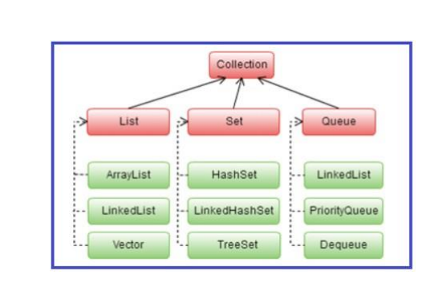

Slide 9
Methods of Collection Interface in Java:
This interface contains various methods that can be directly used by all the collections which implement this interface. They are:
add(Object): This method is used to add an object to the collection.
2. addAll(Collection c): This method adds all the elements in the given collection to this collection.
3. clear(): This method removes all of the elements from this collection.
4. contains(Object o): This method returns true if the collection contains the specified element.
5. containsAll(Collection c): This method returns true if all the collection contains all of the elements in the given collection.
6. equals(Object o): This method compares the specified object with this collection for equality.

Slide 10
7. hashCode(): This method is used to return the hash code value for this collection.
8. isEmpty() : this method return true if this collection contains no elements.
9. iterator(): This method returns an iterator over the elements in this collection.
10. max(): This method is used to return the maximum value present in the collection.
11. parallelStream(): This method returns a parallel Stream with this collection as its source.
12. remove(Object o): This method is used to remove the given object from the collection. If there are duplicate values, then this method removes the first occurrence of the object.
13. removeAll(Collection c): This method is used to remove all the objects mentioned in the given collection from the collection.
14. removeIf(Predicate filter): This method is used to removes all the elements of this collection that satisfy the given predicates.

Slide 11
15. retainAll(Collection c): This method is used to retails only the elements in this collection that are contained in the specified collection.
16. size(): This method is used to return the number of elements in the collection.
17. spliterator(): This method is used to create a Spliterator over the elements in this collection.
18. stream(): This method is used to return a sequential Stream with this collection as its source.
19. toArray(): This method is used to return an array containing all of the elements in this collection.

Slide 12
What is the need for collection framework classes?
In java projects, collection framework classes are used to store and transport objects of the same and different types without size limitation. Project code design with collection framework:
As we know every project has three layers Model, View, and Controller. The model layer application collects data from DB using Result Set and stores it in the collection object and returns this collection object to the controller layer application.
Then the controller layer application reads data from the collection object and fills it in view layer required code using HTML components.
Finally, this HTML code is passed to the client browser displays the result to the end-user

Slide 13
Classes of List Interface
In order to use functionalities of the List interface, we can use these classes:
1. ArrayList
2. LinkedList
3. Vector
4. Stack
These classes are defined in the Collections framework and implement the
List interface.
ArrayList
ArrayList is the implementation class of List Interface which is used to store a group of individual objects where duplicate values are allowed. ArrayList internally follows array structure, which means in ArrayList all the elements are stored in contiguous memory locations same as an array, but ArrayList size is not fixed.

Slide 14
import java.util.ArrayList;
import java.util.List;
public class ArrayListDemo{
public static void main (String[]args)
{
// Creation of ArrayList
ArrayList <Integer> al = new ArrayList <Integer>();
//adding the elements into the list
al.add (10); //autoboxing
al.add (new Integer (20)); //manual boxing
al.add (30);
al.add (40);
al.add (50);
//Display elements of the List and its Size
System.out.println (al);
System.out.println (al.size ());
//inserting an element into the List at specified location
al.add (1, 77);
System.out.println (al);
System.out.println (al.size ());

Slide 15
//modifying the existing element of the List by specifying its value
al.remove (new Integer (30));
System.out.println (al);
System.out.println (al.size ());
//removing the element of the List by specifying its index position
al.remove (0);
System.out.println (al);
System.out.println (al.size ());
//Displaying elements of List 1 by 1 using for loop (accessing)
for (int i = 0; i < al.size (); i++)
{
System.out.println (al.get (i));
}
//Displaying elements of List 1 by 1 using forEach Loop (auto-unboxing)
for (int v:al)
{
System.out.println (v);
}
//Searching an element
System.out.println (al.contains (50));
}
}
[10, 30, 40, 50]
4
[10, 77, 30, 40, 50]
5
[10, 77, 30, 40, 50]
5
[77, 30, 40, 50]
4
77
30
40
50
77
30
40
50
true

Slide 16
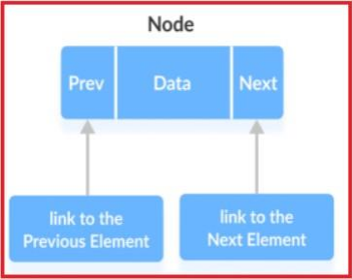
LinkedList
LinkedList is the implementation class of List Interface which is also used to store a group of individual objects where duplicate values are allowed. LinkedList internally follows a doubly linked list structure where all the elements are stored in the form of nodes that linked each other.
1. Prev – stores an address of the previous element in the
list. It is null for the firstelement.
2. Next – Stores an address of the next element in the
list. It is null for the lastelement.
3. Data – Stores the actual data

Slide 17
import java.util.*;
class LinkedListDemo
{
public static void main (String[]args)
{
LinkedList < String > animals = new LinkedList <> ();
// Add elements to LinkedList
animals.add ("Dog");
animals.add ("Cat");
animals.add ("Horse");
System.out.println(animals);
// Get the element from the linked list
String str = animals.get (1);
System.out.print ("Element at index 1: " + str);
System.out.println (" ");
//Iterator method
Iterator < String > itr = animals.iterator ();
while (itr.hasNext ())
{
System.out.println (itr.next ());
}
}
}
[Dog, Cat, Horse]
Element at index 1: Cat
Dog
Cat
Horse

Slide 18
Difference Between ArrayList and LinkedList in Java:
ArrayList is slower in insertion and deletion of elements because it internally requires shifting operations, but faster in accessing the elements because ArrayList uses index position for every element.
LinkedList is faster in insertion and deletion of elements because it just requires modifying the links of nodes instead of shifting operations, but slower in accessing the elements.
Java HashSet
Java HashSet class is used to create a collection that uses a hash table for storage. It inherits the AbstractSet class and implements Set interface.
The important points about Java HashSet class are:
1) HashSet stores the elements by using a mechanism called hashing.
2) HashSet contains unique elements only.
3) HashSet allows null value.
4) HashSet class is non synchronized.

Slide 19
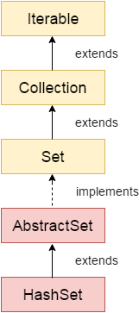
5) HashSet doesn't maintain the insertion order. Here, elements are inserted on the basis of their hashcode.
6)HashSet is the best approach for search operations.
Difference between List and Set
A list can contain duplicate elements whereas Set contains unique elements only.
public class HashSet<E> extends AbstractSet<E> implements Set<E>, Cloneable, Serializable

Slide 20
Methods of Java HashSet class
Various methods of Java HashSet class are as follows:
SN | Modifier & Type | MethodDescription
1 | boolean add(E e) | It is used to add the specified element to this set if it is not already present.
2 | void clear() | It is used to remove all of the elements from the set.
3 | object clone() | It is used to return a shallow copy of this HashSet instance: the elements themselves are not cloned.
4 | boolean contains(Object o) | It is used to return true if this set contains the specified element.
5 | boolean isEmpty() | It is used to return true if this set contains no elements.
6 | Iterator<E> iterator() | It is used to return an iterator over the elements in this set.
7 | boolean remove(Object o) | It is used to remove the specified element from this set if it is present.
8 | int size() | It is used to return the number of elements in the set.
9 | Spliterator<E> spliterator() | It is used to create a late-binding and fail-fast Spliterator over `the elements in the set.

Slide 21
import java.util.*;
class HashSet1
{
public static void main(String[] args)
{
HashSet<String> set=new HashSet();
set.add("one");
set.add("two");
set.add("Three");
Iterator<String> i=set.iterator();
while(i.hasNext())
{
System.out.println(i.next());
}
//Removing specific element from HashSet
set.remove("one");
System.out.println(set);
HashSet<String> set1=new HashSet();
set1.add("one");
set1.add("Four");
set.addAll(set1);
System.out.println(set);
set.removeAll(set1);
System.out.println(set);
set.clear();
System.out.println(set);
}
}
one
two
Three
[two, Three]
[one, Four, two, Three]
[two, Three]
[]

Slide 22
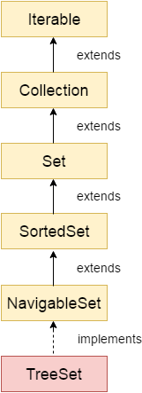
Java TreeSet class
Java TreeSet class implements the Set interface that uses a tree for storage. It inherits AbstractSet class and implements the NavigableSet interface. The objects of the TreeSet class are stored in ascending order.
public class TreeSet<E> extends AbstractSet<E> implements NavigableSet<E>, Cloneable, Serializable

Slide 23
The important points about the Java TreeSet class are:
Java TreeSet class contains unique elements only like HashSet.
Java TreeSet class access and retrieval times are quiet fast.
Java TreeSet class doesn't allow null element.
Java TreeSet class is non synchronized.
Java TreeSet class maintains ascending order.

Slide 24
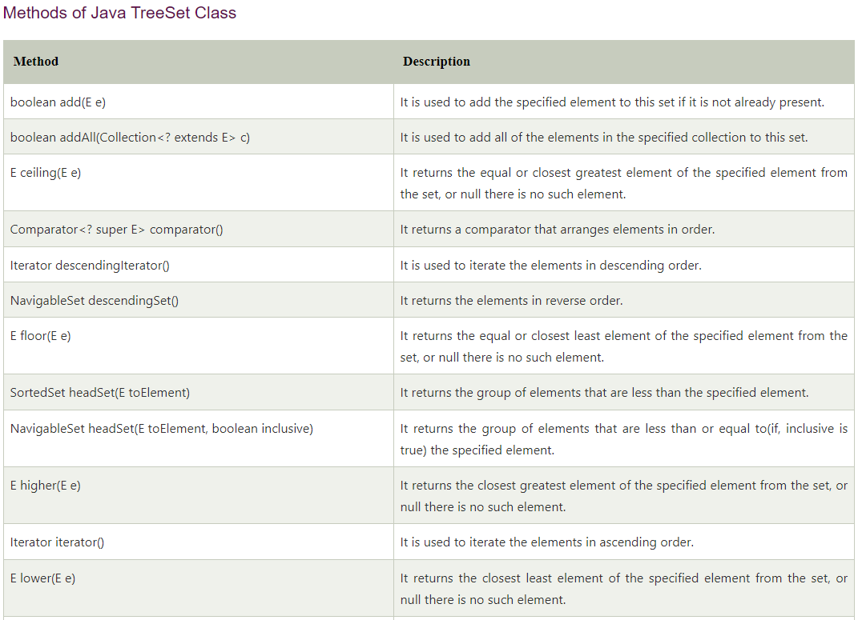

Slide 25
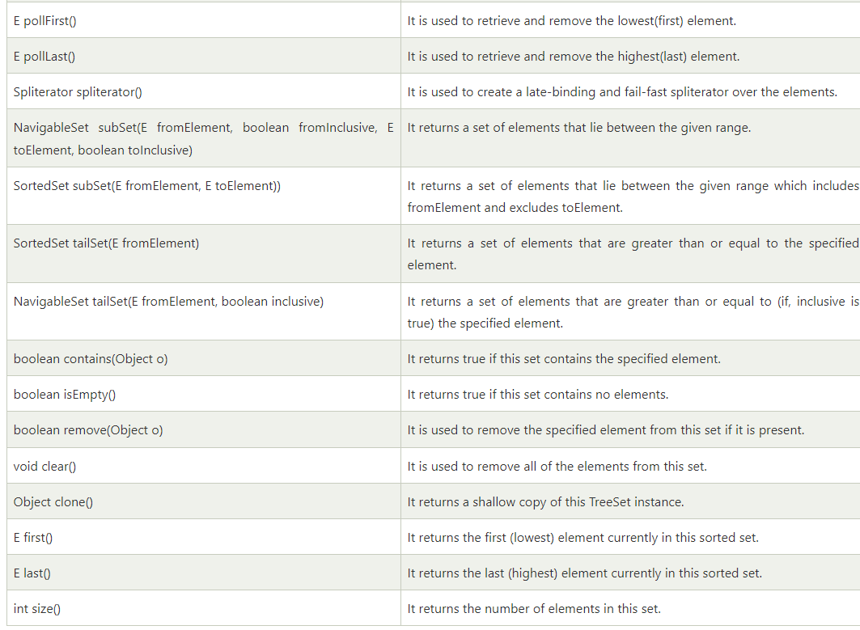

Slide 26
import java.util.*;
class TreeSet1{
public static void main(String args[]){
//Creating and adding elements
TreeSet<String> al=new TreeSet<String>();
al.add("Ravi");
al.add("Vijay");
al.add("Ravi");
al.add("Ajay");
//Traversing elements
Iterator<String> itr=al.iterator();
while(itr.hasNext()){
System.out.println(itr.next());
}
TreeSet<Integer> set=new TreeSet<Integer>();
set.add(24);
set.add(66);
set.add(12);
set.add(15);
System.out.println(set);
System.out.println("Lowest Value: "+set.pollFirst());
System.out.println("Highest Value: "+set.pollLast());
} }
Ajay
Ravi
Vijay
[12, 15, 24, 66]
Lowest Value: 12
Highest Value: 66

Slide 27
Java Queue Interface
The interface Queue is available in the java.util package and does extend the Collection interface. It is used to keep the elements that are processed in the First In First Out (FIFO) manner. It is an ordered list of objects, where insertion of elements occurs at the end of the list, and removal of elements occur at the beginning of the list.
public interface Queue<E> extends Collection<E>

Slide 28
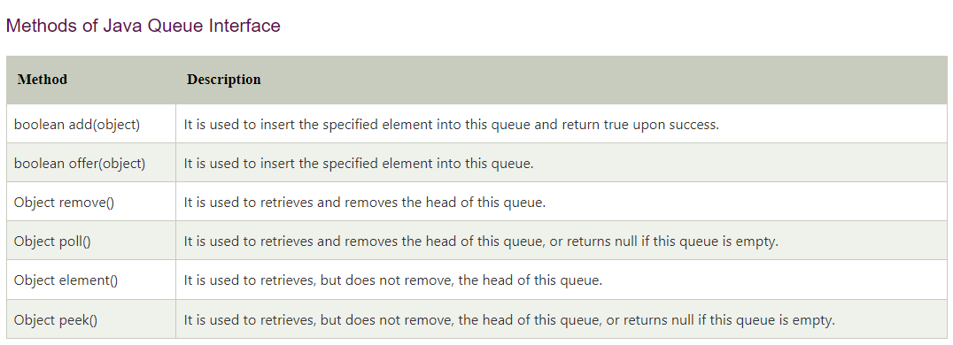

Slide 29
PriorityQueue Class
PriorityQueue is also class that is defined in the collection framework that gives us a way for processing the objects on the basis of priority. It is already described that the insertion and deletion of objects follows FIFO pattern in the Java queue. However, sometimes the elements of the queue are needed to be processed according to the priority, that's where a PriorityQueue comes into action.
public class PriorityQueue<E> extends AbstractQueue<E> implements Serializable

Slide 30
import java.util.*;
class TestCollection12{
public static void main(String args[]){
PriorityQueue<String> queue=new PriorityQueue<String>();
queue.add("Amit");
queue.add("Vijay");
queue.add("Karan");
queue.add("Jai");
queue.add("Rahul");
System.out.println("head:"+queue.element());
System.out.println("iterating the queue elements:");
Iterator itr=queue.iterator();
while(itr.hasNext()){
System.out.println(itr.next());
}
queue.remove();
queue.poll();
System.out.println("after removing two elements:");
Iterator<String> itr2=queue.iterator();
while(itr2.hasNext()){
System.out.println(itr2.next());
}
} }
head:Amit
iterating the queue elements:
Amit
Jai
Karan
Vijay
Rahul
after removing two elements:
Karan
Rahul
Vijay

Slide 31
Iterator in Java
In Java, an Iterator is one of the Java cursors. Java Iterator is an interface that is practiced in order to iterate over a collection of Java object components entirety one by one. It is free to use in the Java programming language since the Java 1.2 Collection framework. It belongs to java.util package.
Java Iterator Methods
It contains a total of four methods that are:
hasNext()
next()
remove()
forEachRemaining()

Slide 32
import java.io.*;
import java.util.*;
public class JavaIteratorExample {
public static void main(String[] args)
{
ArrayList<String> cityNames = new ArrayList<String>();
cityNames.add("Delhi");
cityNames.add("Mumbai");
cityNames.add("Kolkata");
cityNames.add("Chandigarh");
cityNames.add("Noida");
// Iterator to iterate the cityNames
Iterator iterator = cityNames.iterator();
System.out.println("CityNames elements : ");
while (iterator.hasNext())
System.out.print(iterator.next() + " ");
System.out.println();
} }
CityNames elements :
Delhi Mumbai Kolkata Chandigarh Noida

Slide 33
Java For-each Loop | Enhanced For Loop
The Java for-each loop or enhanced for loop provides an alternative approach to traverse the array or collection in Java. It is mainly used to traverse the array or collection elements.
Advantages
It makes the code more readable.
It eliminates the possibility of programming errors.
for(data_type variable : array | collection){
//body of for-each loop
}

Slide 34
import java.util.*;
class ForEachExample2{
public static void main(String args[]){
//Creating a list of elements
ArrayList<String> list=new ArrayList<String>();
list.add("vimal");
list.add("sonoo");
list.add("ratan");
//traversing the list of elements using for-each loop
for(String s:list){
System.out.println(s);
}
} }
vimal
sonoo
ratan

Slide 35
Java I/O Tutorial
Java I/O (Input and Output) is used to process the input and produce the output.
Java uses the concept of a stream to make I/O operation fast. The java.io package contains all the classes required for input and output operations.
We can perform file handling in Java by Java I/O API.
Stream
A stream is a sequence of data. In Java, a stream is composed of bytes. It's called a stream because it is like a stream of water that continues to flow.
In Java, 3 streams are created for us automatically. All these streams are attached with the console.
1) System.out: standard output stream
2) System.in: standard input stream
3) System.err: standard error stream

Slide 36
import java.io.*;
class testfile
{
public static void main(String args[])
{
try
{
File f1=new File("C:\\Users\\MRUH\\Desktop\\javaex\\file\\file.txt");
if(f1.createNewFile())
{
System.out.println("file created");
}
else
{
System.out.println("file exists");
}
}
catch (Exception e)
{
System.out.println("error occured");
e.printStackTrace();
}
}
}
out put
1) file created
2) file exists

Slide 37
import java.io.*;
class testfile1
{
public static void main(String args[])
{
File f2=new File("C:\\Users\\MRUH\\Desktop\\javaex\\file\\file.txt");
if(f2.exists())
{
System.out.println(f2.getName());
System.out.println(f2.length());
System.out.println(f2.getAbsolutePath());
System.out.println(f2.canRead());
System.out.println(f2.canWrite());
}
else
{
System.out.println("file not exists");
}
}
}
output
file.txt
19
C:\Users\MRUH\Desktop\javaex\file\file.txt
true
true

Slide 38
import java.io.*;
class testfile12
{
public static void main(String args[])
{
try
{
FileWriter f3=new FileWriter("C:\\Users\\MRUH\\Desktop\\javaex\\file\\file.txt");
f3.write("hi new file created");
f3.close();
System.out.println("sucess");
}
catch(IOException e)
{
e.printStackTrace();
}
}
}
Out put: sucess
file.txt:hi new file created

Slide 39
import java.io.*;
import java.util.Scanner;
class testfile3
{
public static void main(String args[])
{
try
{
File f4=new File("C:\\Users\\MRUH\\Desktop\\javaex\\file\\file.txt");
Scanner sc=new Scanner(f4);
while(sc.hasNextLine())
{
String data=sc.nextLine();
System.out.println(data);
}
sc.close();
}
catch(IOException e)
{
e.printStackTrace();
}
output: hi new file created

Slide 40
code to print output and an error message to the console.
System.out.println("simple message");
System.err.println("error message");
code to get input from console.
int i=System.in.read();//returns ASCII code of 1st character
System.out.println((char)i);//will print the character

Slide 41
OutputStream
Java application uses an output stream to write data to a destination; it may be a file, an array, peripheral device or socket.
InputStream
Java application uses an input stream to read data from a source; it may be a file, an array, peripheral device or socket.

Slide 42
OutputStream class
OutputStream class is an abstract class. It is the superclass of all classes representing an output stream of bytes. An output stream accepts output bytes and sends them to some sink.
Java FileOutputStream is an output stream used for writing data to a file.
import java.io.FileOutputStream;
public class FileOutputStreamExample {
public static void main(String args[]){
try{
FileOutputStream fout=new FileOutputStream("D:\\testout.txt");
fout.write(65);
fout.close();
System.out.println("success...");
}catch(Exception e){System.out.println(e);}
}
}
Output
Success...
testout.txt : A

Slide 43
import java.io.FileOutputStream;
public class FileOutputStreamExample {
public static void main(String args[]){
try{
FileOutputStream fout=new FileOutputStream("D:\\testout.txt");
String s="Welcome to Stream.";
byte b[]=s.getBytes();//converting string into byte array
fout.write(b);
fout.close();
System.out.println("success...");
}catch(Exception e){System.out.println(e);}
}
}
Output
Success...
testout.txt:Welcome to Stream.

Slide 44
InputStream class
InputStream class is an abstract class. It is the superclass of all classes representing an input stream of bytes.
import java.io.FileInputStream;
public class DataStreamExample {
public static void main(String args[]){
try{
FileInputStream fin=new FileInputStream("D:\\testout.txt");
int i=fin.read();
System.out.print((char)i);
fin.close();
}catch(Exception e){System.out.println(e);}
}
}
testout.txt: Welcome to Stream
Output
W

Slide 45
package com.javatpoint;
import java.io.FileInputStream;
public class DataStreamExample {
public static void main(String args[]){
try{
FileInputStream fin=new FileInputStream("D:\\testout.txt");
int i=0;
while((i=fin.read())!=-1){
System.out.print((char)i);
}
fin.close();
}catch(Exception e){System.out.println(e);}
}
}
Output
Welcome to Stream

Slide 46
Java BufferedOutputStream Class
Java BufferedOutputStream class is used for buffering an output stream. It internally uses buffer to store data. It adds more efficiency than to write data directly into a stream. So, it makes the performance fast.
Java BufferedOutputStream class methods
Method | Description
void write(int b) | It writes the specified byte to the buffered output stream.
void write(byte[] b, int off, int len) | It write the bytes from the specified byte-input stream into a specified byte array, starting with the given offset
void flush() | It flushes the buffered output stream.

Slide 47
import java.io.*;
public class BufferedOutputStreamExample{
public static void main(String args[])throws Exception{
FileOutputStream fout=new FileOutputStream("C:\\Users\\dileep\\Desktop\\javaex\\stream\\ex1.txt");
BufferedOutputStream bout=new BufferedOutputStream(fout);
String s="Welcome to stream.";
byte b[]=s.getBytes();
bout.write(b);
bout.flush();
bout.close();
fout.close();
System.out.println("success");
}
}
we are writing the textual information in the BufferedOutputStream object which is connected to the FileOutputStream object. The flush() flushes the data of one stream and send it into another. It is required if you have connected the one stream with another.
output: success
ex1.txt: Welcome to stream.

Slide 48
Java BufferedInputStream Class
1) When the bytes from the stream are skipped or read, the internal buffer automatically refilled from the contained input stream, many bytes at a time.
2)When a BufferedInputStream is created, an internal buffer array is created.

Slide 49
import java.io.*;
public class BufferedInputStreamExample{
public static void main(String args[]){
try{
FileInputStream fin=new FileInputStream("C:\\Users\\dileep\\Desktop\\javaex\\stream\\ex1.txt");
BufferedInputStream bin=new BufferedInputStream(fin);
int i;
while((i=bin.read())!=-1){
System.out.print((char)i);
}
bin.close();
fin.close();
}catch(Exception e){System.out.println(e);}
}
}
Output : Welcome to stream.

Slide 50
Java Console Class
The Java Console class is be used to get input from console. It provides methods to read texts and passwords.
If you read password using Console class, it will not be displayed to the user.
The java.io.Console class is attached with system console internally.
String text=System.console().readLine();
System.out.println("Text is: "+text);

Slide 51
import java.io.Console;
class cons{
public static void main(String args[]){
Console c=System.console();
System.out.println("Enter your name: ");
String n=c.readLine();
System.out.println("Welcome "+n);
}
}

Slide 52
Java Console Example to read password
import java.io.Console;
class ReadPasswordTest{
public static void main(String args[]){
Console c=System.console();
System.out.println("Enter password: ");
char[] ch=c.readPassword();
String pass=String.valueOf(ch);//converting char array into string
System.out.println("Password is: "+pass);
}
}

